Slide 1
Vanishing Gradient Issue in ANN
Jayaraj P B
1

Slide 2
Outline
Vanishing/Exploding Gradients Problems
Glorot and He Initialisation
Activation functions
Better Activation Functions

Slide 3
Vanishing/Exploding Gradients Problems
The backpropagation algorithm works by going from the output layer to the input layer, propagating the error gradient on the way.
Once the algorithm has computed the gradient of the cost function with regards to each parameter in the network, it uses these gradients to update each parameter with a Gradient Descent step.
Unfortunately, gradients often get smaller and smaller as the algorithm progresses down to the lower layers. As a result, the Gradient Descent update leaves the lower layer connection weights virtually unchanged, and training never converges to a good solution.
This is called the vanishing gradients problem.

Slide 4
In some cases, the opposite can happen: the gradients can grow bigger and bigger, so many layers get insanely large weight updates and the algorithm diverges.
This is the exploding gradients problem, which is mostly encountered in recurrent neural networks

Slide 5
Looking at the logistic activation function, you can see that when inputs become large (negative or positive), the function saturates at 0 or 1, with a derivative extremely close to 0. Thus when backpropagation kicks in, it has virtually no gradient to propagate back through the network, and what little gradient exists keeps getting diluted as backpropagation progresses down through the top layers, so there is really nothing left for the lower layers

Slide 6
Glorot and He Initialization
They are the initialization methods for neural networks that take into account the non-linearity of activation functions, such as ReLU activations.
When training deep neural networks, the initialization of the weights can significantly affect how well and how quickly the model learns. Two widely used initialization techniques are Glorot (or Xavier) Initialization and He Initialization. These methods are designed to address the vanishing and exploding gradients problems, ensuring that the signal flows properly through the network both during forward propagation and backpropagation.

Slide 7
The Need for Proper Initialization
In a neural network, the signal needs to flow correctly in two directions:
Forward Direction: When making predictions, the input data is passed through the network to generate an output.
Reverse Direction: During backpropagation, the error gradient is propagated back through the network to update the weights.
For the network to learn effectively, we want the signal to neither die out nor explode. This means maintaining a consistent variance of the outputs and gradients through each layer.

Slide 8
Better Activation Functions
One of the insights in the 2010 paper by Glorot and Bengio was that the vanishing/exploding gradients problems were in part due to a poor choice of activation function.
But it turns out that other activation functions behave much better in deep neural networks, in particular the ReLU activation function, mostly because it does not saturate for positive values (and also because it is quite fast to compute).

Slide 9
Activation Function
An activation function in the context of neural networks is a mathematical function applied to the output of each neuron or node in a layer of the network.
Activation functions can be linear (e.g., f(x)=αx) or non-linear (e.g., sigmoid function).
Its primary role is to introduce non-linearity into the model, allowing the network to learn and approximate complex patterns, relationships, and functions in the data.
Non-linear functions are crucial for tackling real-world problems with intricate feature relationships.

Slide 10
Common Activation Functions
In the realm of neural networks, several activation functions are commonly used.
Linear: The identity function f(x)=x is a basic linear activation, unbounded in its range.
ReLU: Standing for rectified linear unit, ReLU is a widely-used non-linear function.
Sigmoid: This function outputs values between 0 and 1, ideal for probability-based models.
Tanh: The tanh function outputs values between -1 and 1, effectively mapping negative inputs to negative outputs.

Slide 11
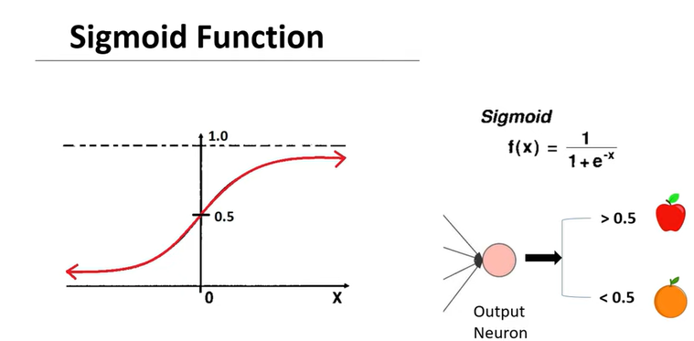
Activation Functions

Slide 12
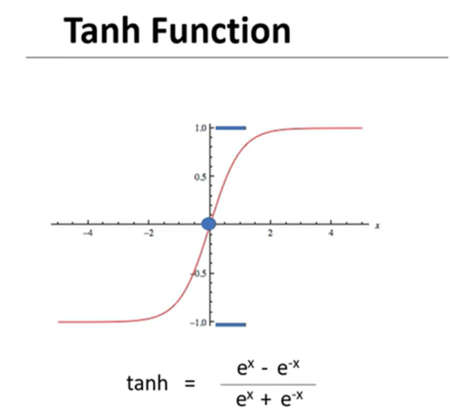

Slide 13
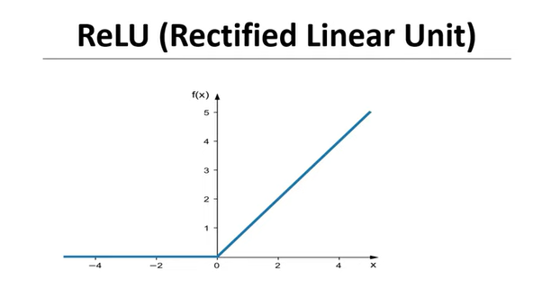
ReLU formula is : f(x) = max(0,x)

Slide 14
Unfortunately, the ReLU activation function is not perfect. It suffers from a problem known as the dying ReLUs: during training, some neurons effectively die, meaning they stop outputting anything other than 0. In some cases, you may find that half of your network’s neurons are dead, especially if you used a large learning rate.
A neuron dies when its weights get tweaked in such a way that the weighted sum of its inputs are negative for all instances in the training set. When this happens, it just keeps outputting 0s, and gradient descent does not affect it anymore since the gradient of the ReLU function is 0 when its input is negative

Slide 15
The Dying ReLU Problem:
Cause: The dying ReLU problem occurs when neurons only receive negative input. When this happens, the output of the ReLU function is zero. As a result, during the backpropagation process, there is no gradient flowing through the neuron, and its weights do not get updated.
Impact: Once a ReLU neuron gets stuck in this state where it only outputs zero, it is unlikely to recover. This is because the gradient through a neuron is zero when its output is zero. Consequently, the neuron becomes inactive, essentially ‘dying’, and ceases to play any role in discriminating the input.
Resulting Issues: If many neurons in a network ‘die’, it can lead to a substantial loss of capacity in the network, and the network may fail to fit or generalize the data properly. This is especially problematic in deeper networks with many layers.

Slide 16
To solve this problem, you may want to use a variant of the ReLU function, such as the leaky ReLU. This function is defined as LeakyReLU α(z) = max(αz, z).
The hyperparameter α defines how much the function “leaks”: it is the slope of the function for z < 0, and is typically set to 0.01. This small slope ensures that leaky ReLUs never die; they can go into a long coma, but they have a chance to eventually wake up.
They also evaluated the randomized leaky ReLU (RReLU), where α is picked randomly in a given range during training, and it is fixed to an average value during testing. It also performed fairly well and seemed to act as a regularizer

Slide 17
Parametric ReLU (PReLU)
Parametric ReLU (PReLU) is an advanced variation of the traditional ReLU and Leaky ReLU activation functions, designed to further optimize neural network performance.
PReLU improves upon Leaky ReLU by making the slope a learnable parameter, enhancing model accuracy and convergence. Yet, fine-tuning this parameter can be time-consuming, especially with diverse datasets.
PReLU has shown effectiveness in various applications, particularly in fields where capturing complex patterns is crucial, like computer vision and speech recognition.

Slide 18
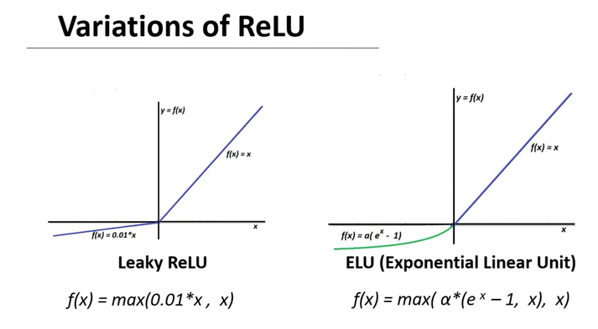

Slide 19
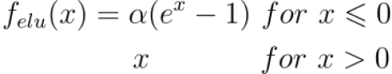
ELU or exponential linear unit is a new and highly accurate well-used activation function in hidden layers. It is a parameterized function, i.e. it has a parameter (it is technically a hyper-parameter or tunable parameter) called alpha, symbol α. The ELU returns the number itself if it’s positive, and gives alpha multiplied by the exponentiated input subtracted by 1.

Slide 20

Scaled Exponential Linear Unit
The SELU or the Scaled Exponential Linear Unit is the modification of the ELU, which better aids in improving accuracy and normalizing. An additional hyperparameter lambda is added, symbol λ. The SELU is given as,

Slide 21
Gaussian Error Linear Unit (GeLU)
GeLU is a smooth approximation of the rectifier function, scaling inputs by their percentile rather than their sign, offering another alternative in the ReLU family.
GeLU has gained notable popularity in transformer architectures, such as those used in models like BERT and GPT, where it has shown to improve performance in natural language understanding tasks.

Slide 22
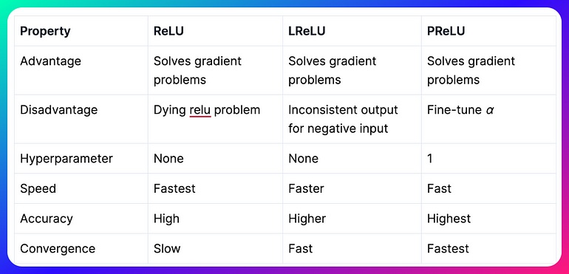
ReLU vs. Leaky ReLU vs. Parametric ReLU

